Slide 1

Project Title –Seasonal Agriculture Performance Analysis
Student name – Vaishnav Mapadi
College name -pillai hoc college of engineering and technology
AICTE STU ID : STU6a46161e1c7241782978078

Slide 2

PROBLEM STATEMENT
Agricultural activities are influenced by seasonal variations in environmental conditions, farming practices, resource availability and market conditions. As a result, agricultural performance may differ from one season to another. However, raw agricultural data does not clearly explain how agricultural performance changes across seasons or what patterns can be observed in different seasonal conditions. The problem is to analyze the given agricultural dataset and investigate seasonal differences in agricultural performance by identifying meaningful patterns, trends, relationships and variations within the available data.

Slide 3
Project Description :-
This project is an exploratory data analysis of a seasonal agriculture performance dataset covering 4,000 farm records across 8 Indian states, 8 crops, and 3 growing seasons (Kharif, Rabi, Zaid). The dataset combines agronomic inputs — rainfall, soil conditions, fertilizer and pesticide use, irrigation method, seed quality — with financial outcomes: yield, production, revenue, cost, and profit.
The goal of the analysisis to understand what actually drives farmprofitability andproductivity, and toidentify which crops,states, seasons, andfarming practicesdeliver the strongestreturns. The workflowfollows a complete dataanalytics pipeline:initial data inspection,quality checks(duplicates, missingvalues), categorical andnumerical profiling,statisticalsummarization, andcomparativeperformance analysisacross crops, states, andseasons. It then goes alayer deeper withcorrelation analysis toisolate which inputvariables most influenceyield and profit, and areview of irrigationmethod effectiveness.
The result is a data-driven picture ofagriculturalperformance — showing,for example, thatwater-use efficiency andcrop choice matter farmore to profitabilitythan fertilizer intensityor even geographiclocation — framed asinsights that couldsupport agriculturaladvisory, policy, or agri-finance decision-making.

Slide 4

WHO ARE THE END USERS?
1. Farmers / Farmer groups
2. Agricultural extension officers / advisory services
3. State agriculture departments / policymakers
4. Agri-fintech and insurance companies
5. Agribusiness and supply chain companies
6. Researchers / data analysts (like you, here)

Slide 5

Technology Used
Environment – google collab
Language – python
Libraries – pandas, numbpy, Mathplot ,seaborn
Techniques - Exploratory Data Analysis (EDA) , Data cleaning , Descriptive statistic , Group-by aggregation , Correlation analysis, Data visualization / dashboarding

Slide 6
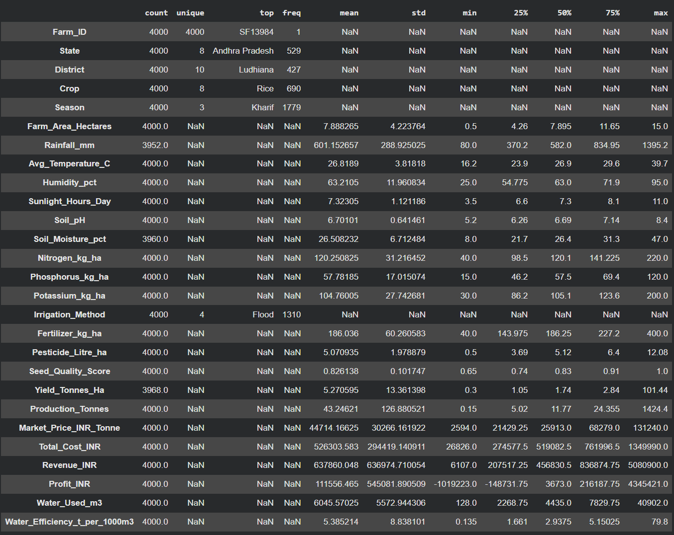
RESULTS : complete information of dataset
[Add screen shots of your code ]

Slide 7
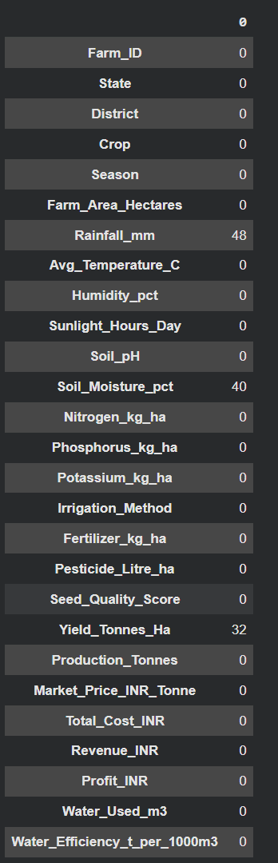
Checking missing values :-

Slide 8
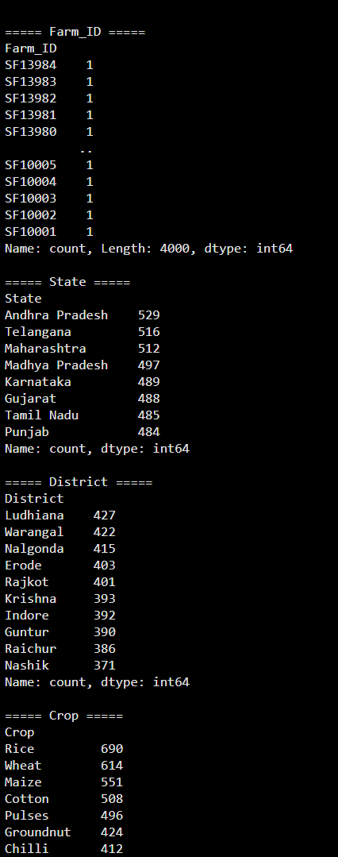
Categorial column :-

Slide 9
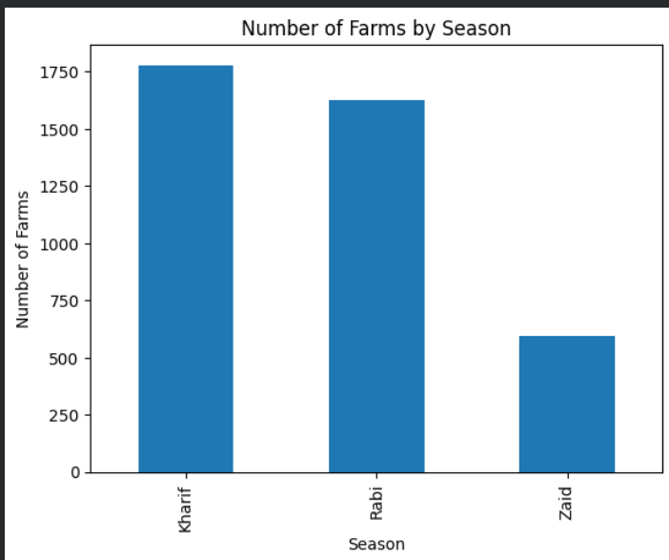

Slide 10
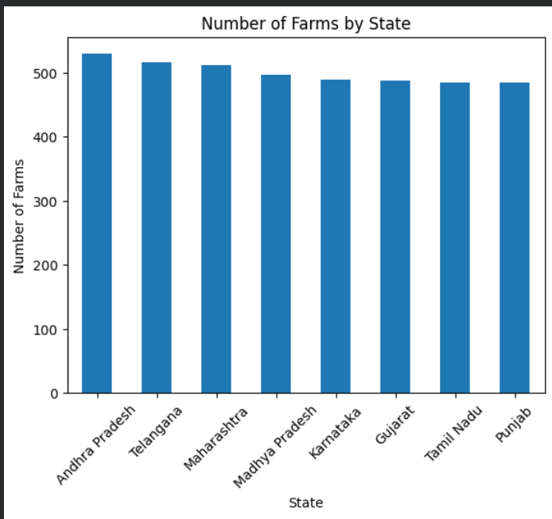

Slide 11
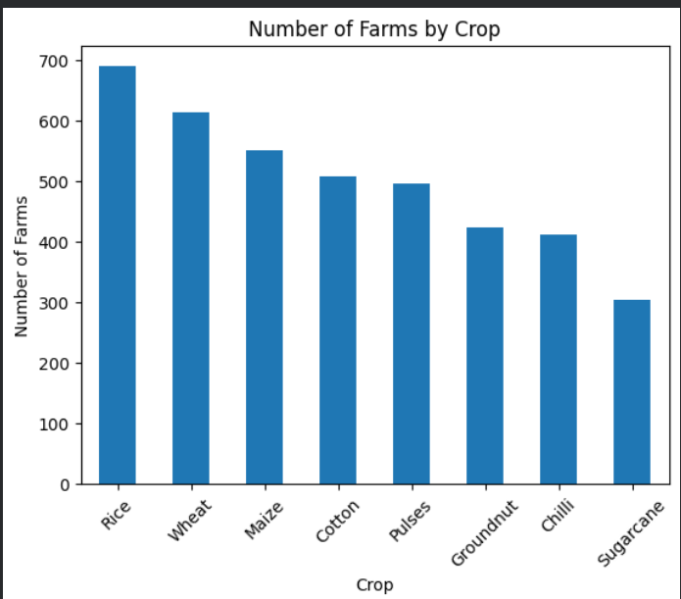

Slide 12
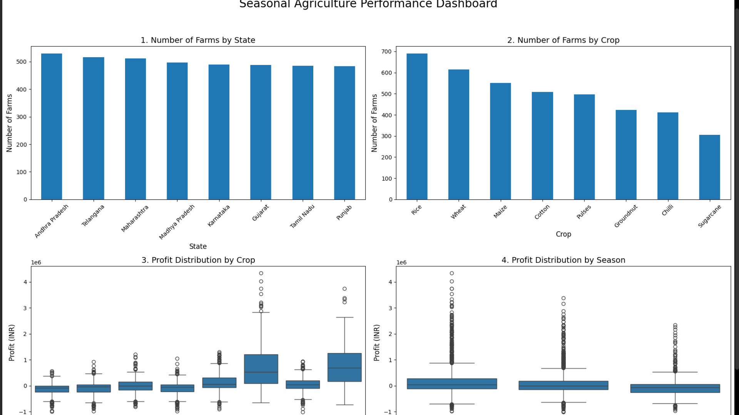

Slide 13
Future scope
Build predictive models (yield/profit forecasting, loss-risk prediction)
Integrate real-time weather, soil, and market price data
Deploy as an interactive dashboard for farmers/officers
Add geospatial (district-level) analysis
Extend to multi-year data for trend analysis
Use insights for crop insurance and farm advisory recommendation systems
Incorporate sustainability metrics (water/environmental impact) alongside profit

Slide 14
GitHub Link
https://github.com/vaishnavmapadi45/seasonal_-agriculture_crop-analysis

Slide 15
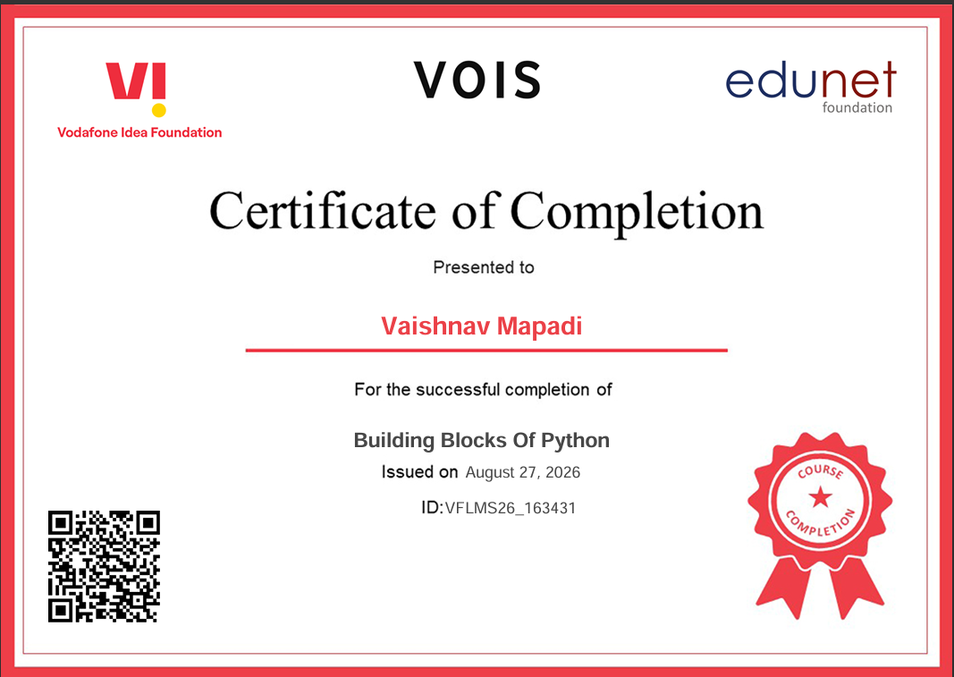
VOIS Course completion certificate - Course name- Data Visualization

Slide 16
Thank you !!!
.
.

